Slide 1
COMPUTING ETHICS
Roshan Bhakta – Kyle St. Leger-Barter – Brandon Stradling – Stephen Strong– Ting Tang – Duc Tran – Victor Trigueros
Arizona State University – Fall 2012

Slide 2
Overview
Artificial Intelligence
The Digital Divide
Plagiarism in Education
Conclusion
Discussion
References

Slide 3
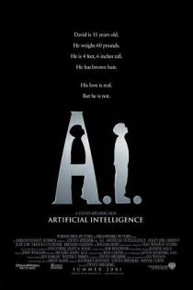
Artificial Intelligence
"The science and engineering of making intelligent machines, especially intelligent computer programs”
"Related to the similar task of using computers to understand human intelligence”
– John McCarthy

Slide 4
History
1956 – The field of AI research was founded at the Dartmouth Conferences.
1963 – ARPA funds McCarthy's AI research
1965 – ELIZA, a program that can talk to users on any topic, was created at MIT.
1968 – MIT's MacHack became the first program to play in human chess tournaments.

Slide 5
History
1970s – The expert system Mycin was developed; could provide medical analysis with a knowledge base
1991 – DARPA's DART was deployed in the Gulf War to optimize logistical problems.
2011 – IBM's Watson defeats Brad Rutter and Ken Jennings in Jeopardy!

Slide 6
AI – Military Applications

Slide 7
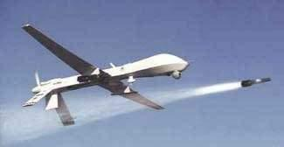
Military Applications
WW2 Gun director
Target identification
Guided missiles
Unmanned Aerial Vehicles (UAV)
XM-25
Automated robots may be deployed in 20 years
Notes:
The first use of a computer in military was back in World War II. Gun directors were used to help ground gunners to locate the path of a plane using radar data.
UAV drones have been used since the Vietnam war. There are also Unmanned Ground Vehicles and Unmanned Underwater Vehicles
XM-25 Munitions programmed to detonate at behind cover without contact

Slide 8
Concerns of Military Use of AI
Automated robots would reduce the number of human casualties, but robots would be left to make decisions on their own.
Concerns over whether an AI can distinguish between civilians and combatants.

Slide 9
Concerns of Military Use of AI
No clear way to determine who is accountable for a mistake made by AI
Human Rights Watch calls for the ban of production of these "killer robots”

Slide 10
Ethical Concerns
Is the use of AI (e.g. guided missiles and sentry guns) a person using a tool to kill the enemy, or is it the AI who is doing the killing?
Is it ethical to lay the blame of attacking enemies on the AI program?
To what extent can we replace humans with AI and robots in war?

Slide 11
AI - Threat To Human Privacy and Dignity

Slide 12
Internet Privacy
Websites use cookies from Google Adsense to determine which ads to display.
AI data-mining allows vendors to advertise products you'd most likely buy.

Slide 13
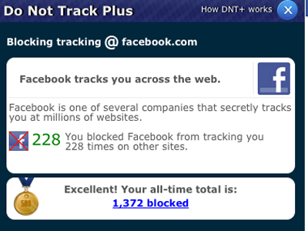
Internet Privacy
Facebook tracks user data using cookies, Javascript, 1-pixel beacons, & Iframes.
  They pull personal data from external websites

Slide 14
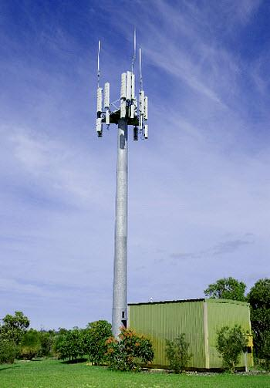
Cell Phone Privacy
Police stations can track your cell phone.
Gilbert Police Dept. have installed a system that can track the location of your cell phone unless it is turned off.
In LA Police have cloned phones and downloaded their text messages.

Slide 15
AI & Privacy
According to previous Google CEO Eric Schmidt
  Young people will someday be allowed to change their name to distance themselves from material gathered on them from social media sites.
  Eventually Google will know so much about its users that it will be able to help people plan their lives.
  "I actually think most people don't want Google to answer their questions. They want Google to tell them what they should be doing next."
  Ex: Google could remind you what groceries you'd like to buy when passing a shop.

Slide 16
Ethical Concerns
Is it ethical to sacrifice our privacy in order to obtain a higher quality of life?
Do we need to redefine what is considered private and public data?
Will it be possible to prevent private data from getting into the wrong hands?

Slide 17
AI & Human Dignity
Joseph Weizenbaum
  German-Jewish refugee to the US in 1936.
  Very influential in the computer world.
  Professor of Computer Science at MIT.
  Wrote a simple AI in 1966 called ELIZA.
  Felt that computers are incapable of having feelings like humans, which he argues is an important characteristic when making judgment calls

Slide 18
ELIZA
young woman: Men are all alike.
eliza: In what way?
young woman: They're always bugging us about something specific or other.
eliza: Can you think of a specific example?
young woman: Well, my boyfriend made me come here.
eliza: Your boyfriend made you come here?
young woman: He says I'm depressed much of the time.
eliza: I am sorry to hear you are depressed.
...
eliza: What else comes to mind when you think of your father?
young woman: Bullies.
eliza: Does that have anything to do with the fact that your boyfriend made you come here?

Slide 19
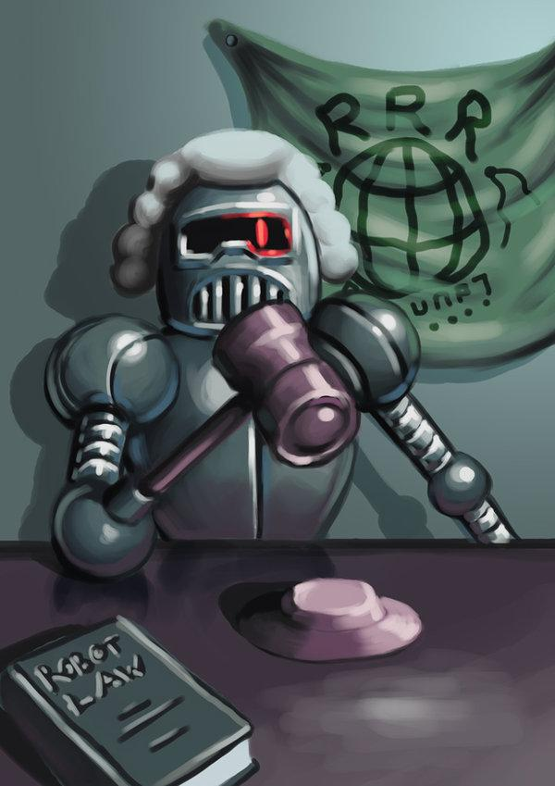
Ethical Concerns
Is it ethical to have AI working in positions such as:
  Judge
  Police Officer
  Customer Service
  Therapist (such as ELIZA)

Slide 20
Robo-Ethics

Slide 21
Three Laws of Robotics
A robot may not injure a human being or, through inaction, allow a human being to come to harm.
A robot must obey the orders given to it by human beings, except where such orders would conflict with the First Law.
A robot must protect its own existence as long as such protection does not conflict with the First or Second Laws.

Slide 22
AI Accountability
Artificially intelligent beings have a capability to execute actions on its own initiative
Ownership and Liability
  Who would be liable for the actions?
  Punishment and Punitive Damages
  Owners can be punished and pay damages
  Do machines feel pain to be punished?
  Can behavior be adjusted through punishment?

Slide 23
AI Rights
Responsibility and accountability implies understanding of consequences
  Artificially intelligent beings are endowed with inalienable rights
Limitation of rights
  Procreation: Can robots make more sentient robots?
  Suffrage: Can a robot be President?

Slide 24
Looking Ahead With AI

Slide 25
Looking Ahead
Artificial Intelligence has potential to further enrich our lives in the future:
Medical
allow doctors to have better information
Legal
potential for unbiased decisions
Educational
education tailored to individual needs

Slide 26
Looking Ahead
What privacy issues will we encounter in the future as AI continues to advance?
Even though AI has the potential to further enrich our lives, does society want or need these services, especially considering the potential loss of rights and privacy?

Slide 27
The Digital Divide

Slide 28
What is Digital Divide?
It is the gap between people who have access to digital technology – such as computers, Internet, mobile phones, etc. – and those who have very limited access or have no access at all.

Slide 29
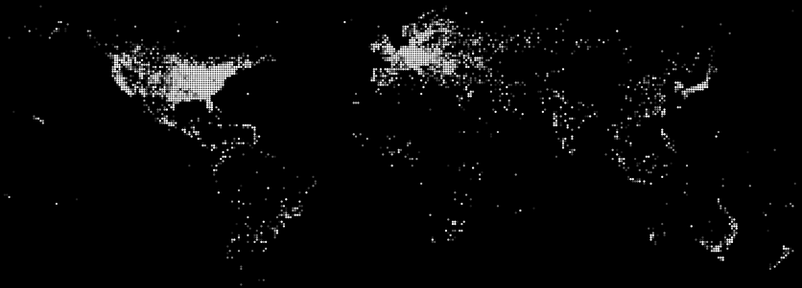
World Connection Density
"Only 30 percent of the world population currently has access…"Global Post
Notes:
http://chartsbin.com/embed/1884?static=1
http://www.globalpost.com/dispatch/news/politics/diplomacy/120706/un-deems-internet-access-basic-human-right-0

Slide 30
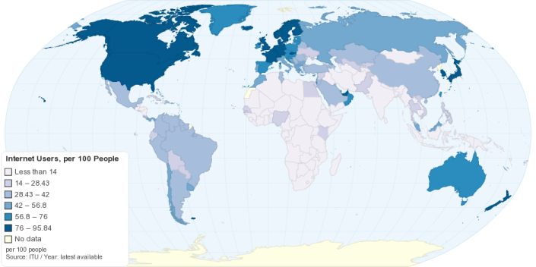
Internet Users / 100
Notes:
http://chartsbin.com/view/1884

Slide 31
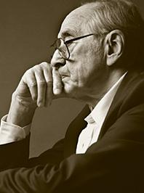
Alvin Toffler
“The illiterate of the 21st century will not be those who cannot read and write, but those who cannot learn, unlearn, and relearn. ”
Notes:
http://www.goodreads.com/author/show/3030.Alvin_Toffler
American writer and futurist, known for his works discussing the digital revolution, communications revolution, corporate revolution and technological singularity. A former associate editor of Fortune magazine, his early work focused on technology and its impact (through effects like information overload.
Accenture, the management consultancy, has dubbed him the third most influential voice among business leaders, after Bill Gates and Peter Drucker. He has also been described in the Financial Times as the "world's most famous futurologist". People's Daily classes him among the 50 foreigners that shaped modern China.

Slide 32
Past & Present
In the past - Classified as those have access to internet and those who don't.
Now - Classified as those to have access to technology and those to don't.

Slide 33
Why Does it Exist?
Lack of technological skills
Imposed restrictions
Lack of access or resources
People lacking opportunities

Slide 34
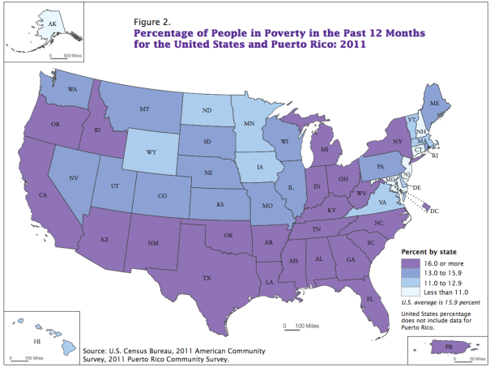
Poverty!
US Average 2011
  15.9 %
People under 18
  22%
People 19–64
  13.7%
People ages 65+
  9%
Notes:
http://www.census.gov/prod/2012pubs/acsbr11-01.pdf

Slide 35
Why Poverty is of Major Concern?
Because these are the people that desperately need access to the internet, the ones that would benefit most from the resources available online (e.g. Medicare, Social Security information, job searching …)

Slide 36
Bridging the Gap
The United Nations has ruled that Internet access is a basic human right that should be guaranteed and protected by states.
The government has allocated $7.2 billion for broadband development as part of the stimulus package.

Slide 37
Bridging the Gap
Access to Technology through Schools
  Nearly universal in the U.S.
  No Child Left Behind
  Telecommunications Act of 1996
Notes:
http://www.internetinnovation.org/blog/entry/broadband-grants-on-the-way/
http://www.globalpost.com/dispatch/news/politics/diplomacy/120706/un-deems-internet-access-basic-human-right-0

Slide 38
Bridging the Gap
Total – 121,785
Notes:
** Special libraries include Corporate, Medical, Law, Religious, etc.
http://www.ala.org/research/sites/ala.org.research/files/content/initiatives/plftas/issuesbriefs/connectivitybrief_2009_10_final.pdf

Slide 39
Ethical Concerns
Denial of Access
Blocking & Filtering
  21 states have Internet filtering laws for public schools or libraries
    Internet Use Policies
    Filtering Software
Notes:
State of ILLINOIS has no such laws

Slide 40
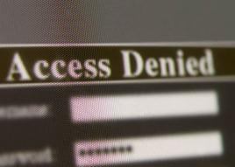
Denial Of Access
Children’s Internet Protection Act (CIPA)
  Requires the use of filtering software to block access to websites with offensive photos or materials (In order to participate in the E-Rate program to receive financial support from the government).

Slide 41
Content Filtering
National Coalition Against Censorship
  Filtering: Limits the free exchange of ideas
Filtering operates by keywords, many studies suggest frequent examples of over blocking.
Notes:
http://www.ncac.org/
http://www.fepproject.org/factsheets/filtering.html

Slide 42
Plagiarism in Education

Slide 43
Evolving Definition
With the arrival of the internet and the 'information age', the definition of plagiarism is changing
Some students construe Wikipedia as 'common knowledge'
Only 29% of students think copying from web is 'serious cheating'

Slide 44
Evolving Definition
Growing disconnect between concepts of intellectual property, copyright and originality
40% of undergrad students admitted to copying 'a few sentences'

Slide 45
What’s causing the change in perception of plagiarism?
Students are sitting at the same computer they may download music and movies with.
Students aren't grabbing a physical copy of a reference from a library anymore, and may make it easier for a student to feel like the source 'belongs' to them instead of 'borrowing' it.

Slide 46
What’s causing the change in perception of plagiarism?
Students are mixing-and-matching with easily copied-and-pasted sources, rather than "engaging in the writing process."

Slide 47
Plagiarism in software related degrees.
Many forms of academic dishonesty in CS: student collaboration, copying code from online sources.
Plagiarism of students' programs is harder to detect than ordinary plagiarism in writing.

Slide 48


Plagiarism in software related degrees.
Cognitive dissonance within CS programs: students are told not to collaborate on certain projects or in certain classes, yet in other projects (and in industry) you are encouraged to take others' code and modify/improve as needed.
The advent of open source projects available on sites like bitbucket and github also blur the identity of plagiarism in CS courses.

Slide 49

How are Schools dealing with evolving plagiarism?
TurnItIn.com - a site which checks for plagiarism against a database of collected papers and sources.
Students are often required to upload their projects to sites like TurnItIn in order to receive a grade.

Slide 50
How are Schools dealing with evolving plagiarism?
However, it has been argued that turning in a paper to TurnItIn.com creates a 'presumption of guilt' - which means you are guilty until proven innocent, which may conflict with local and scholastic laws and/or codes of conduct.
There have also been complaints of student copyright abuse because it stores papers in the TurnItIn database permanently

Slide 51
Litigation Involving
Jesse Rosenfield, student at McGill U, declined to submit work to TurnItIn.
University Senate decided they were to be graded without TurnItIn.
Princeton, Harvard, Yale and Stanford have banned use of TurnItIn.
2007, two high school students from Desert Vista High School sued iParadigms, TurnItIn's parent company, but the decision went in favor of the company both in the first decision and in the court of appeals.

Slide 52
Conclusion
Artificial Intelligence
  Military, Privacy, Robo-Ethics
The Digital Divide
  Poverty, Bridging the Gap, Denial of Access
Plagiarism in Education
  Evolving Definition, Software, Schools, Litigation

Slide 53
Discussion Questions
Is it ethical to bypass Web filtering software placed by schools in order to reach a website which has no direct offensive content?
With many people supporting claims of dismissing software patents, is it ethical holding patent to a software which contains ideas present elsewhere?

Slide 54
References
http://www.nytimes.com/2010/08/02/education/02cheat.html?pagewanted=all&_r=0
http://en.wikipedia.org/wiki/Turnitin
http://www.thecrimson.com/article/2006/5/4/fighting-plagiarism-schools-go-high-tech-what/
http://courses.cs.vt.edu/~cs3604/support/Debates/Scenarios.html
http://www.cs.utsa.edu/~wagner/pubs/plagiarism0.html
http://en.wikipedia.org/wiki/Ethics_of_artificial_intelligence
http://en.wikipedia.org/wiki/Joseph_Weizenbaum#cite_note-2
http://en.wikipedia.org/wiki/Digital_divide
http://www.google.com/policies/privacy/ads/
http://www.theglobeandmail.com/technology/dear-valued-customer-thank-you-for-giving-us-all-your-personal-data/article582786/
http://www.homelandsecuritynewswire.com/dr20120404-aclu-cell-phone-tracking-by-police-widespread
http://www.stanford.edu/group/SHR/4-2/text/dialogues.html#note7

Slide 55
References
http://www.businessinsider.com/this-is-how-facebook-is-tracking-your-internet-activity-2012-9?op=1
http://www-formal.stanford.edu/jmc/whatisai/node1.html
http://en.wikipedia.org/wiki/History_of_artificial_intelligence
Pentti O. Haikonen, Robot Brains: Circuits and Systems for Conscious Machines
http://en.wikipedia.org/wiki/Timeline_of_artificial_intelligence
http://www.gizmag.com/xm-25-us-army-smart-weapon/11807/
http://www.taibahu.edu.sa/iccit/allICCITpapers/pdf/p30-siddiqi.pdf
http://www.telegraph.co.uk/technology/google/7951269/Young-will-have-to-change-names-to-escape-cyber-past-warns-Googles-Eric-Schmidt.html
http://phys.org/news/2012-11-killer-robots-rights-group-urges.html
http://phys.org/news/2012-04-robots-wars-blamed-battlefield.html
Isaac Asimov, I, Robot
http://www.globalpost.com/dispatch/news/politics/diplomacy/120706/un-deems-internet-access-basic-human-right-0
http://chartsbin.com/view/1884

Slide 56
References
http://www.nytimes.com/2012/04/01/us/police-tracking-of-cellphones-raises-privacy-fears.html?pagewanted=all&_r=0
http://www.internetinnovation.org/blog/entry/broadband-grants-on-the-way/
http://www.ala.org/research/sites/ala.org.research/files/content/initiatives/plftas/issuesbriefs/connectivitybrief_2009_10_final.pdf
http://www.fcc.gov/guides/childrens-internet-protection-act
http://www.ncac.org/
http://www.fepproject.org/factsheets/filtering.html
http://www.goodreads.com/author/show/3030.Alvin_Toffler

